Slide 1
Diodes, Variable Resistors and Transducers

Slide 2
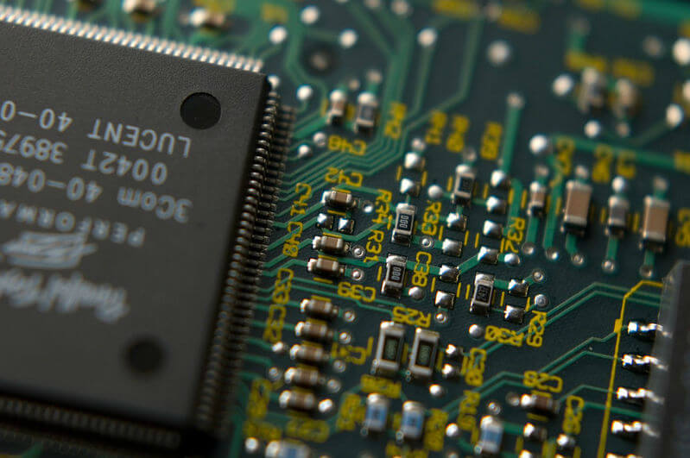
In this extension Smart Lesson you will learn to:
Recall the use of semiconductors in electronic components such as diodes.
Explain the basic functions of diodes, variable resistors and transducers.

Slide 3
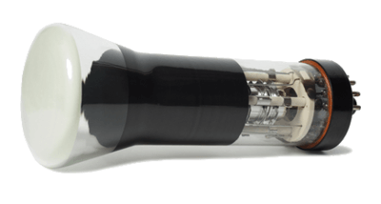
Now we're going to look at some new components, starting with diodes.
A diode contains semiconducting material, like silicon or germanium, that changes its properties depending on which way current flows.
In particular, the resistance of a diode can be next to zero when connected the proper way, or practically infinite when connected the opposite way. The effect of this is that current can only pass through a diode in one direction.

Slide 4

Circuit symbol.
This is the symbol we use to represent a regular diode on a circuit diagram. The arrowhead shows its preferred orientation in a circuit.
If the diode is connected so that current can flow in the direction of the arrowhead, we say it is forward biased. If it's connected the opposite way, it is reverse biased and current cannot pass through.

Slide 5
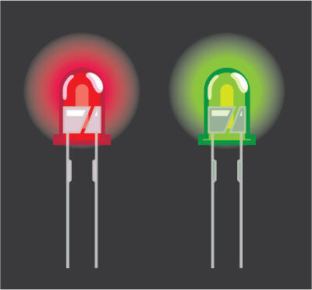
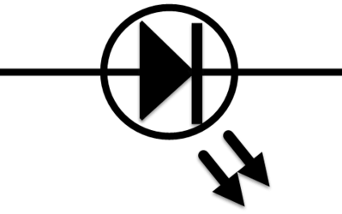
A light-emitting diode (LED) is a very common type of diode that lights up when current passes through it the right way.
LEDs come in a few different varieties and have many uses.
They are found in indicator and bicycle lights, in torches and traffic lights, and as efficient substitutes for normal lamps. As diodes, they only light up if they are forward biased in a circuit. If an LED is placed in a circuit where the current alternates - changes direction periodically - it will flash on and off.
This is the circuit symbol for an LED. It looks just like the one for a normal diode, but with an added circle and two arrows to show light being given off.

Slide 6
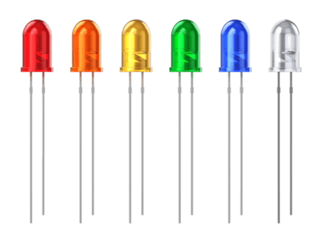
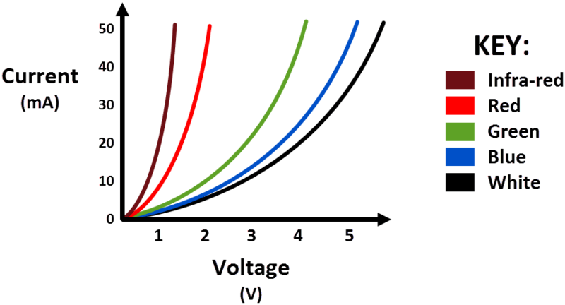
LED colours.
You have probably seen a red LED before, but they are made with many other colours as well. The reason red ones are so abundant is because they require only a small voltage to work. Red light has the longest wavelength of any colour in the visible spectrum.
It turns out that as the wavelength of light decreases, you need a higher voltage to be able to emit the corresponding colour. This is summarised in the graph below, which compares the required voltages for different types of LEDs at different current levels. Notice that all the lines are curved, because LEDs are non-ohmic conductors.

Slide 7
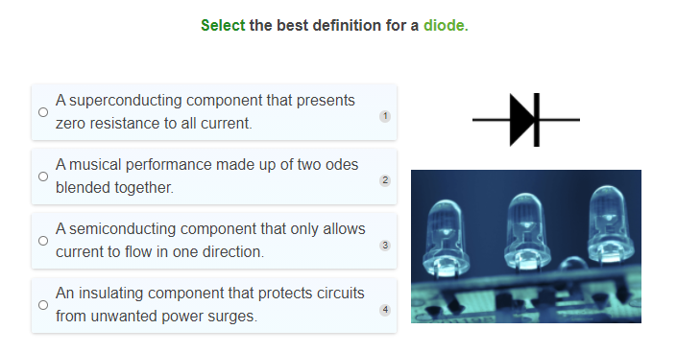

Slide 8
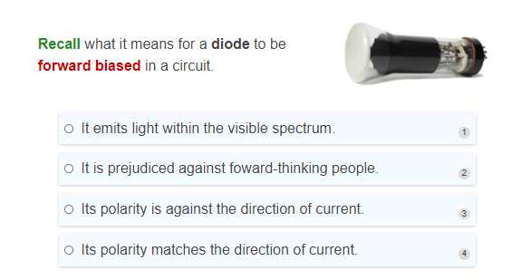

Slide 9
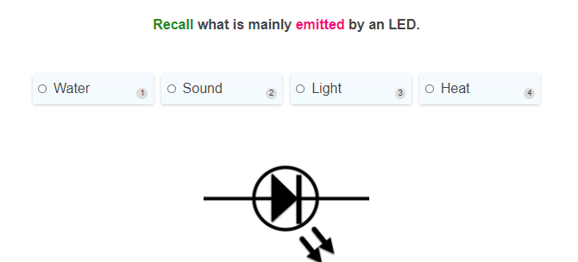

Slide 10
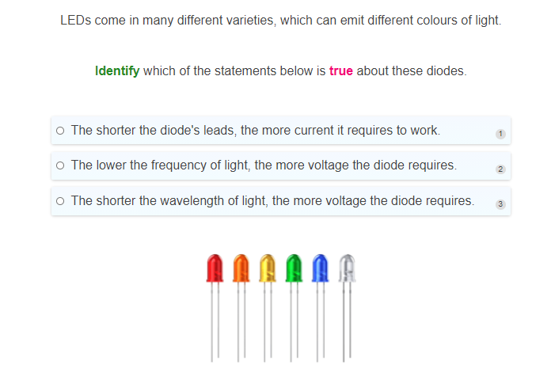

Slide 11
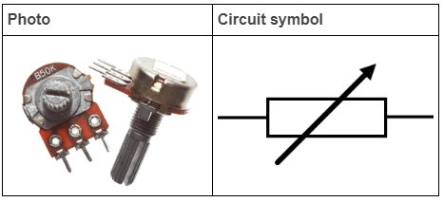
There are also different types of resistor that we can use in circuits.
So far we've considered passive resistors that sit around with a fixed resistance.
A potentiometer is a common form of variable resistor, which can change its resistance. It contains an adjustable contact that can be rotated with a cylindrical dial. The contact itself is a metal pin which is moved inside an arc-shaped track made of graphite. Really, it's just a voltage divider that you can tune.
Potentiometers are used in audio equipment and other circuits where tuning is required.

Slide 12
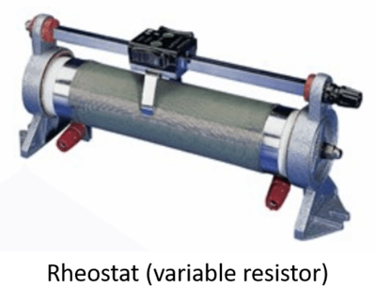
You may have other types of variable resistor in the lab, or may even build your own.

Slide 13
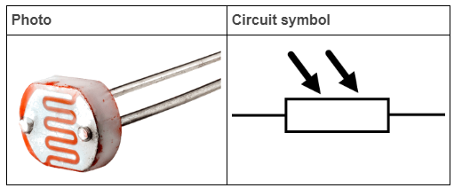
Light-dependent resistor.
A light-dependent resistor (LDR) is not controlled by a sliding contact. Instead, it is sensitive to changes in light intensity.
The LDR contains a combination of cadmium sulfide (CdS) and cadmium selenide (CdSe), which decrease the component's resistance when light intensity increases. In other words, exposing an LDR to bright light will dramatically improve its ability to conduct electricity.

Slide 14
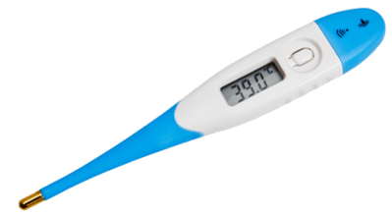
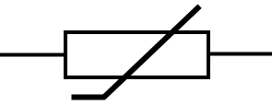
The last type of variable resistor we'll look at is called a thermistor.
Its resistance changes in response to a change in temperature - depending on how it's made, the resistance will either increase or decrease.
Thermistors are used in many devices where temperature must be measured or regulated. The most obvious examples are in digital thermometers, and in control circuits of heaters and air conditioners.
Here is the circuit symbol for a thermistor:

Slide 15
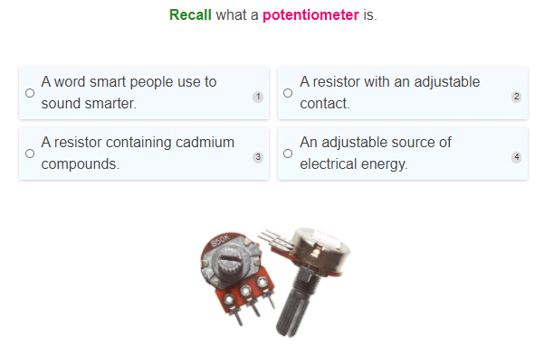

Slide 16
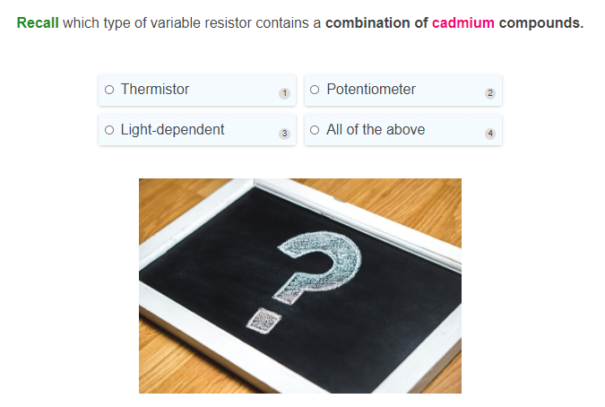

Slide 17
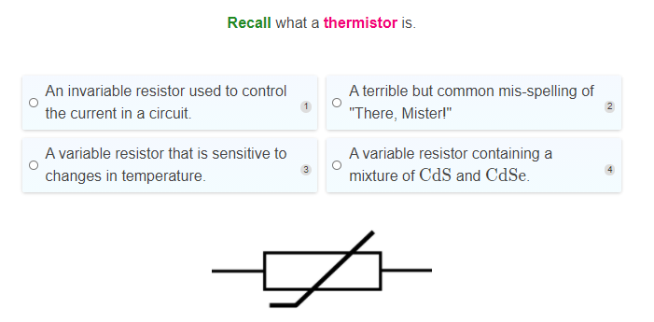

Slide 18
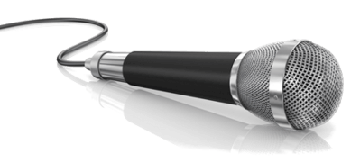
As in all of Physics, one of the key ideas in circuits is the concept of energy.
We cannot see energy directly, but we can observe what happens when it's converted from one form to another. A battery contains chemical potential energy that is slowly converted to electrical energy, which then powers our circuits.
An input transducer is a device that produces electricity from some other form of energy. A microphone is a good example of this. When you speak into a microphone, it receives sound energy from you and transforms it into electrical signals.

Slide 19
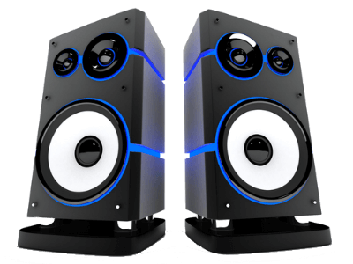
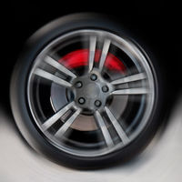
An output transducer does the opposite - it takes electrical energy from a circuit and converts it into something else.
For instance, a loudspeaker can receive electrical signals and convert them to sound. We won't worry much about how it does this. What's important is the transformation of energy that takes place!
Another common example is the electric motor. This device converts electrical energy into mechanical energy, which is used to produce motion. Motors like this are found in all sorts of vehicles, power tools and other machinery.

Slide 20
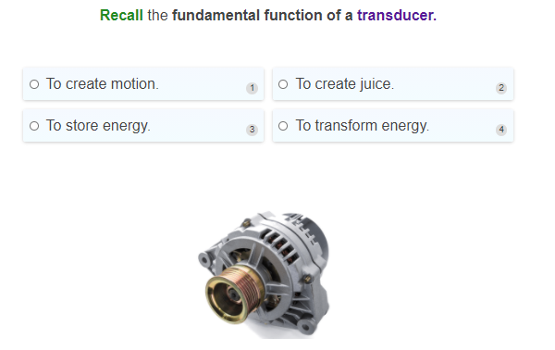

Slide 21
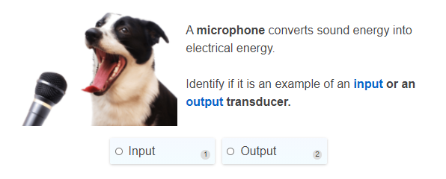

Slide 22
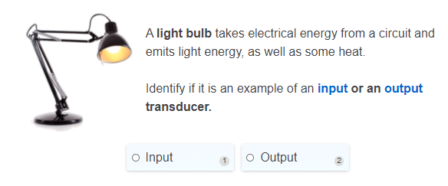

Slide 23
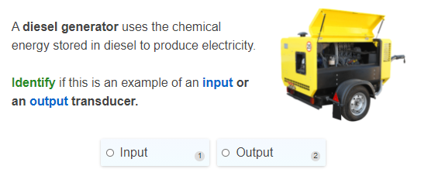

Slide 24


Slide 25
